Slide 1
Vertica Studio Magnify your efficiency
Shaik Abdul Wahab

Slide 2



Big data platform
Functional coverage
Vertica Overview
Vertica Studio Overview
Performance metrics
Tool demo
Vertica Studio - Prerequisites

Slide 3
Market demand overview
What are the key technology requirements of a Big Data analytics platform? So, just what should you look for in a data analytics solution to address today and tomorrow’s data challenges?
Manage huge data volumes: You are likely looking to scale limitlessly to store or manage massive volumes. Today, the scale may be gigabytes or terabytes. Tomorrow, you may be thinking about petabytes.
Deliver fast analytics: Users don’t want to wait for results. Your solution should provide the scalability to meet service-level agreements (SLAs) and expected timeframes for running a query.
Embrace legacy tools: If your Big Data analytics relies on extract, transform, load (ETL) tools or SQL-based visualizations, your analytics platform should provide robust and powerful SQL and also be certified to work with all of your tools—not just those from your primary vendor.
Support data scientists: The new breed of data scientists are using tools like Java, Python, and R to create predictive analytics. The underlying analytical database should support and accelerate the creation of innovative predictive analytics.
Advanced analytics: Depending upon your use case, it may be important to look at the depth of built-in SQL analytical functions offered by the analytics engine.

Slide 4
Vertica Overview
Vertica is a true columnar, MPP, Analytic database
Vertica is just a DBMS like Oracle, Teradata and MySQL
Vertica is made for strong Structured and semi-structured data
It supports standard SQL like other Databases
Designed for speed, scalability, simplicity and openness that are critical to the success of Analytics
Relies on a tested, reliable distributed architecture and columnar compression to deliver blazingly fast speed
Complete and advanced SQL-based analytical functions to provide powerful SQL analytics
A clustered approach to storing Big Data, offering superior query and analytic performance
Better compression, requiring less hardware and storage than comparable data analytics solutions
Flexibility and scalability to easily ramp up when workloads increase
Better load throughput and concurrency with querying
Built-in predictive analytics
Notes:
Unlock Business Insights with Blazingly Fast Performance
A massively parallel approach to Big Data that makes the best use of all your nodes to deliver analytics
Faster data loads and higher concurrency lets you serve analytics to more users with more data
Flexibility and scalability to easily add a node and ramp up when workloads increase
Columnar storage, so that your queries access only the data they need to answer the query

Slide 5

Vertica Studio Overview
Objective
To ease the day to day operations of the Vertica DBAs.
Business case
DBA’s spend lot of time and effort in performing their day to day Vertica operations through physical monitoring, routine checks, generate routine reports etc.,
They are tend to make human errors for various reasons
They spend significant time while doing multiple operations as they need to wait and watch till one execution is complete before starting the next. Physical intervention is always required for continuous executions
Chances of not following the standards are high as they are currently being done manually
Business outcomes
Easy to use and perform day to day operations
Saves a lot of time and effort through automated executions
No room for human errors as the tool generate recursive SQLs internally
Performance improvements through bulk operations

Slide 6
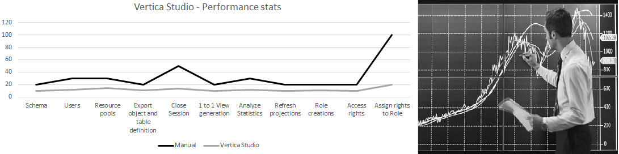
Vertica Studio - Performance
** Above statistics are indicative in minutes for 10 objects executed in a Development environment

Slide 7
Vertica Studio - Prerequisites

Slide 8

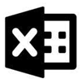

Vertica Studio - Environmental requirements
Microsoft Windows operating system
Microsoft Excel Application
Vertica Database Connectivity
Vertica ODBC Driver for Windows
Define a data source (DSN) for each Vertica Database prior connecting to ODBC
Saving the password in DSN as it is mandatory for Vertica Studio.

Slide 9
Vertica Studio - Functional Coverage

Slide 10
Vertica Studio - Functions
Create and Drop Schemas
Create, Alter and Drop Users
Create, Alter and Drop Resource Pools
Export Objects definition and Export Table definition
Close Session and Interrupt Statement
1 to 1 View Generation
Analyze and Drop Statistics
Refresh Projections in foreground
Create, Alter, Drop Roles and Assign/Revoke Role to Users
Grant and Revoke Access Rights
Create and Drop Read/DML/DDL Roles and assign respective Access Rights to Role
Export Result set

Slide 11
Vertica Studio - Functions – Cont.
Run an SQL query
Generate Long Running Queries and Close the Selected Sessions
Generate Resource Consuming Queries and Close the Selected Sessions
Create Backup Empty and Populated tables with multiple approaches
Set and Get the Configuration Parameter Values
Close All Sessions
Run MAKE_AHM_NOW
Run START_REFRESH & CANCEL_REFRESH which runs on background.
Run DO_TM_TASK
Generate Epoch Report which gives AHM Epoch/Current Epoch/Last Good Epoch

Slide 12
Vertica Studio - Demo

Slide 13
Contact me at
shaik-abdul.wahab@dxc.com

Slide 14
Thank you
About DXC Technology
DXC Technology (DXC: NYSE) is the world’s leading independent, end-to-end IT services company, helping clients harness the power of innovation to thrive on change. Created by the merger of CSC and the Enterprise Services business of Hewlett Packard Enterprise, DXC Technology serves nearly 6,000 private and public sector clients across 70 countries. The company’s technology independence, global talent and extensive partner network combine to deliver powerful next-generation IT services and solutions. DXC Technology is recognized among the best corporate citizens globally. For more information, visit www.dxc.com.

